Slide 1

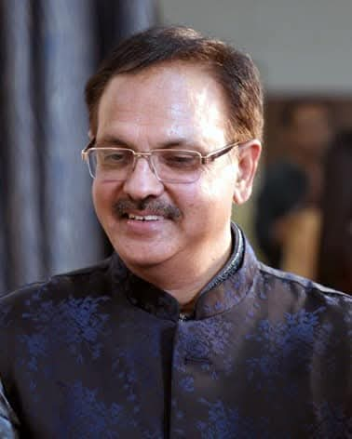
Dr Adesh Saxena MS ENT
Director and CEO Shri Ashwini Saxena Hospital
Rewari

Slide 2

Academic Excellence
MBBS 1983, University College of Medical Sciences, Delhi University
MS (ENT) 1987, Safdarjung Hospital, Delhi University
Thesis for PG was extremely path breaking “ External Rhinoplasty "where Actual cadaveric dissections were carried out along with surgeries on patients in 1985 “

Slide 3

Accolades
Received Gold Medal and Prestigious Smt Mukut Saharia Award 1987 at AOI Delhi
Was a faculty in First RHINOCON in 1987 in Delhi
Presented paper and poster at Rhinocon in Jeddah KSA 1994 and European Rhinocon in June 1994 at Copenhagen .

Slide 4

Positions held
Former Secretary of AOI (Association of Otolaryngologists of India) Haryana
Former President of AOI (Association of Otolaryngologists of India) Haryana
Former Patron AOI (Association of Otolaryngologists of India) Haryana
Former President IMA Rewari
Former President Lions Club of Rewari
Former President Shri Chitragupt Sabha Rewari
Haryana Representative of NISS (National Initiative for Safe Sound)

Slide 5
Organised Haryana AOICONs /Awareness Camps
In 2007 as Org Sec at Rewari ,Two-day Conference with 13 live surgeries ,Memorable academics , vibrant cultural extravaganza and Instituted the Prestigious ASHWINI SAXENA ORATION @ ANNUAL HARAYAN AOICON first time in 2007 and now for last 18 years , honouring eminent ENT Luminaries .
Organised Haryana AOICON in Thailand as Org Chairperson in October 2019.
Awareness camps for Safe Sound Initiative / Free New born hearing Screening in all deliveries @ Shri Ashwini Saxena Hospital since 2015.First Cochlear Implant surgery in Rewari on
Always encouraged and promoted Academics ,Ethics ,Empathy and Mentorship
Participated actively as Speaker ,Panelist ,Chairperson in National and International Conferences

Slide 6
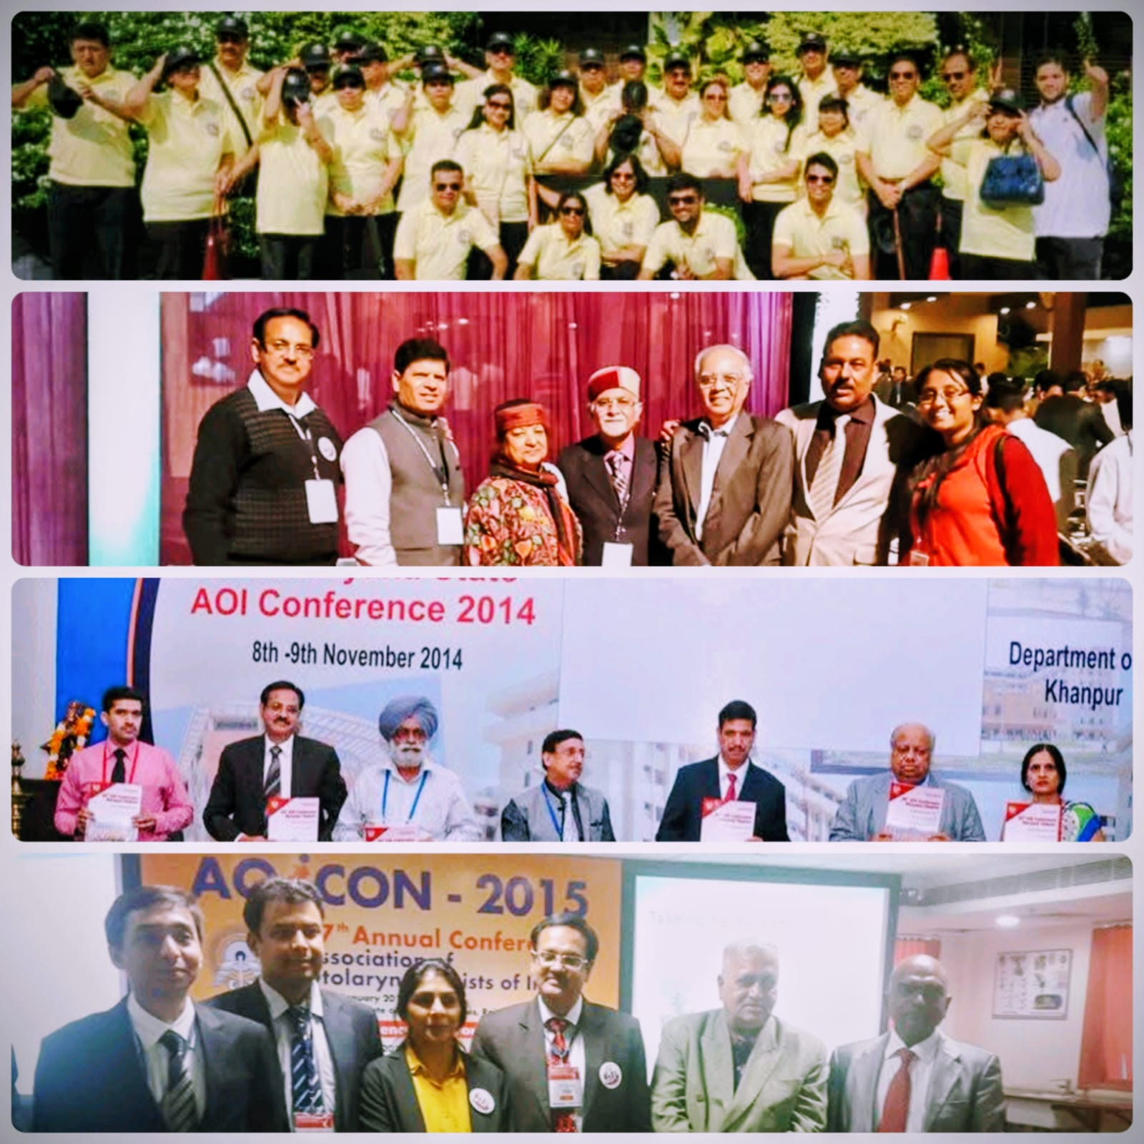
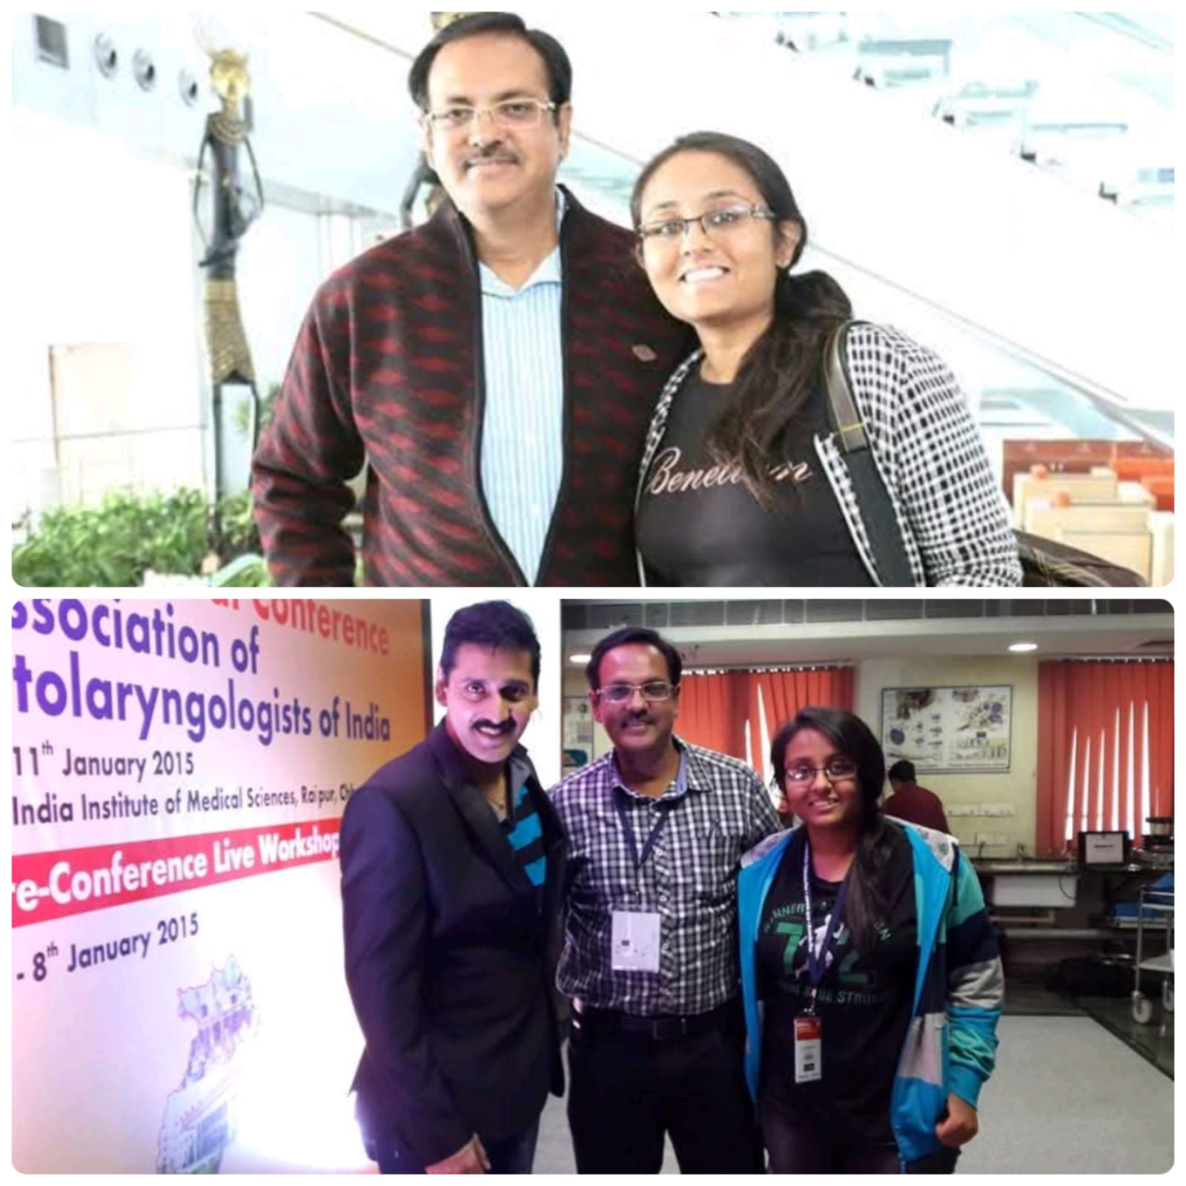

Slide 7
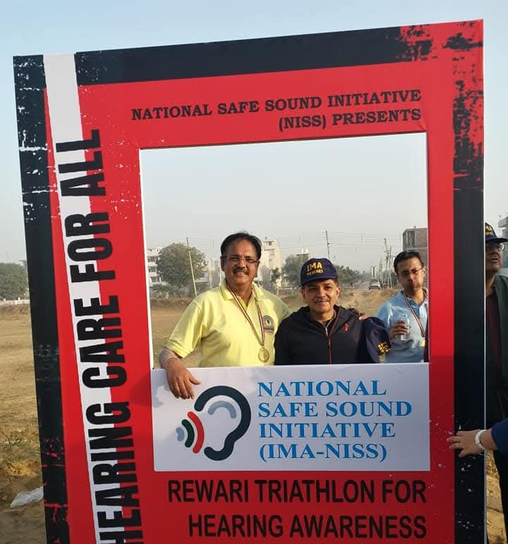
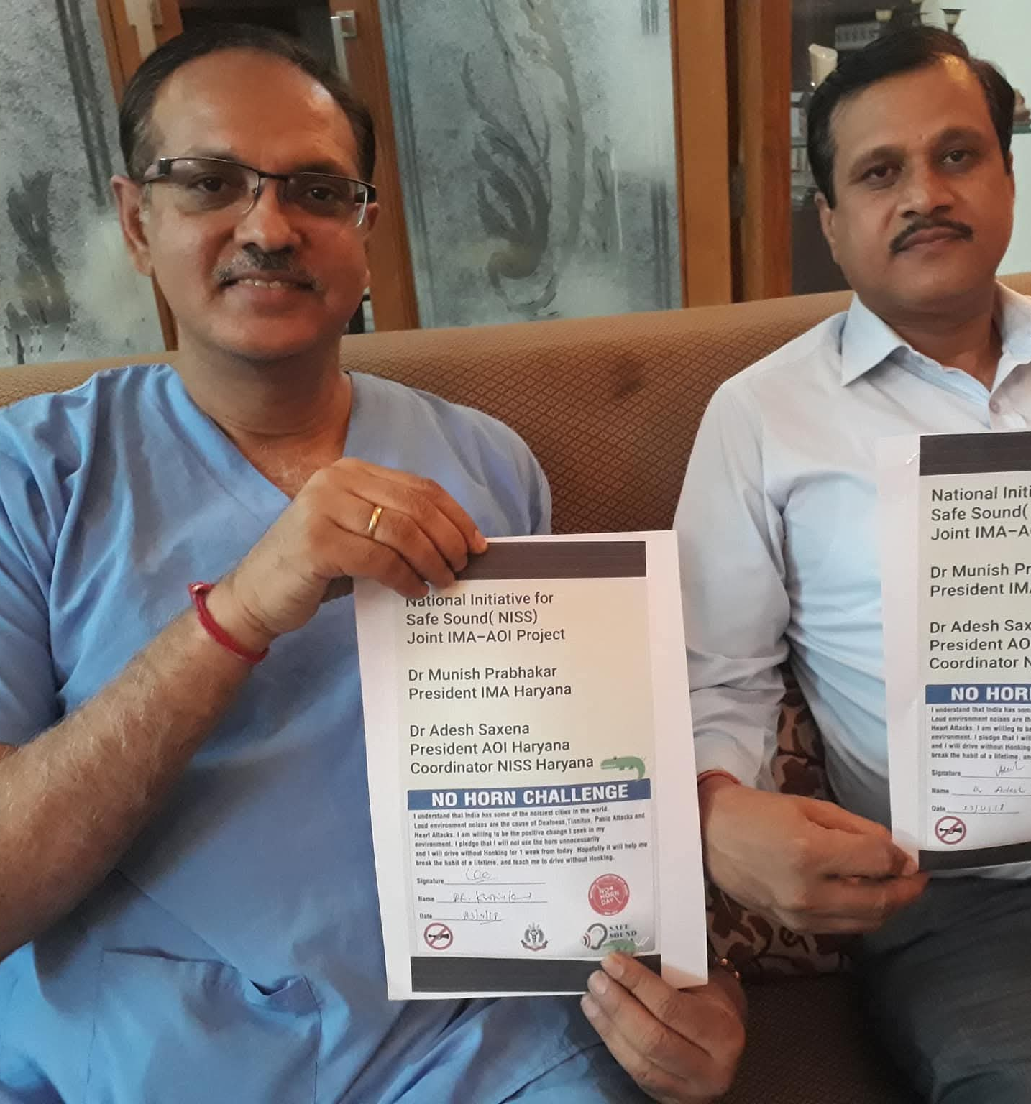

Slide 8

Surgical Expertise: Ear Surgeries/ RHINOPLASTIES
Special Interest Areas
Advanced Ear Surgeries
Performing complex otological procedures with precision and expertise, restoring hearing and treating ear disorders
Cochlear Implant Surgery
Transforming lives through cochlear implantation, providing the gift of sound to patients with profound hearing loss.
Rhinoplasty

Slide 9
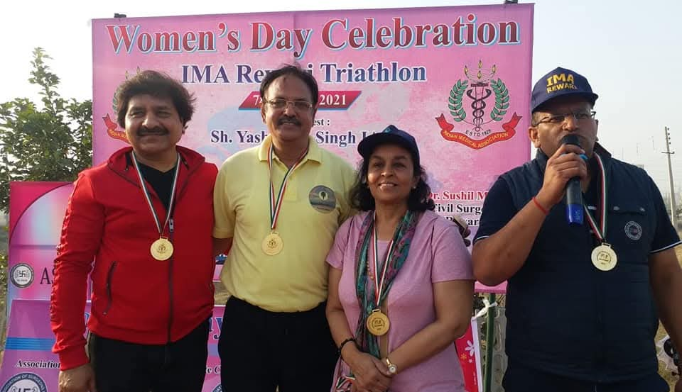
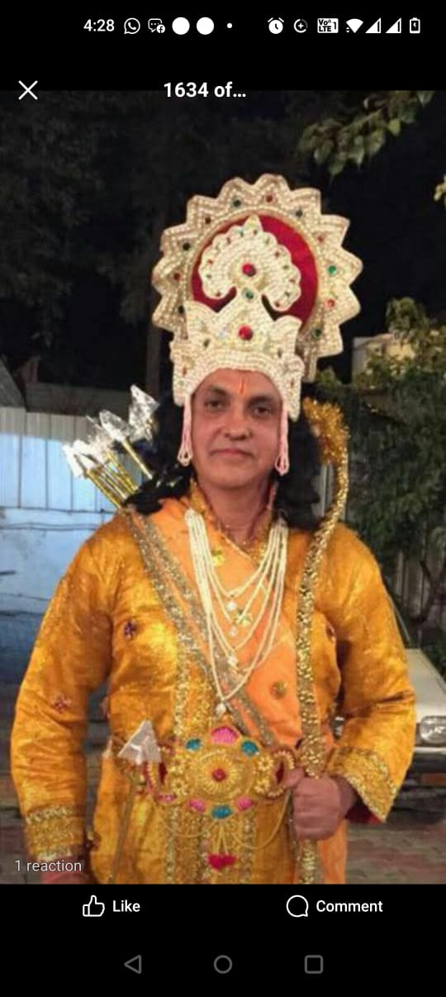
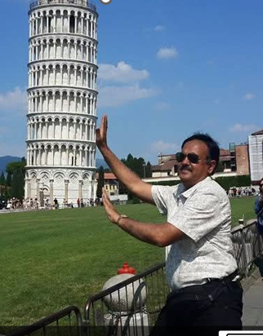
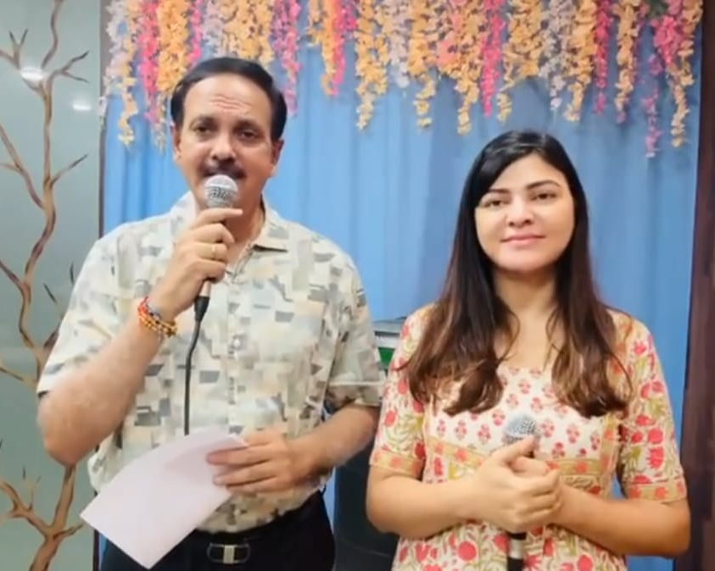
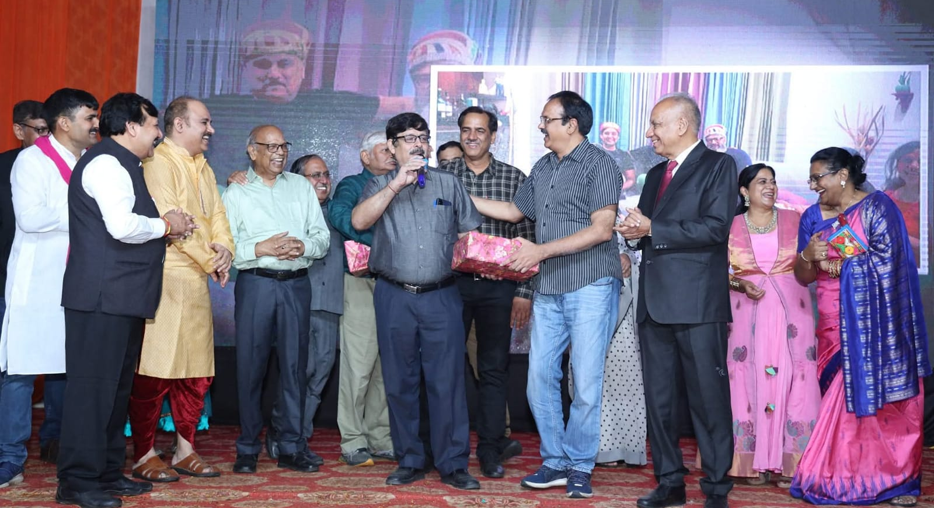
Beyond Medicine: A Life of Passion
A multitalented personality ,an acclaimed Singer ,Sportsperson ,a Philanthropist,A Travel Freak ,Socially active role model for the young doctors of Rewari city and Haryana State .

Slide 10

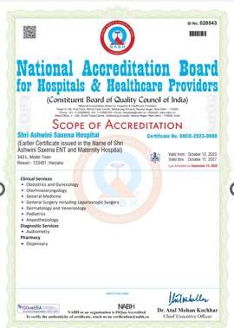
A Family of Healers
Dr Adesh Saxena is founder of Shri Ashwini Saxena hospital along with his wife Dr Mitra Saxena, a senior ObGyn ,a state of Art facility catering to rural Haryana.
They have contributed to the ENT services of the region by inspiring two dedicated and talented young ENT surgeons a daughter and a son , Dr Ashima and Dr Akshay Saxena to join this noble journey ,from Silence to Sound .
Dr Akshay Agnihotri an acclaimed Retinal Surgeon,trained at Arvind hospital Madurai , USD ,USA, Royal Adelaide Hospital Australia and Dr Anchal Dixit Saxena a sincere ethical proficient Dermatologist are part of the family team .

Slide 11
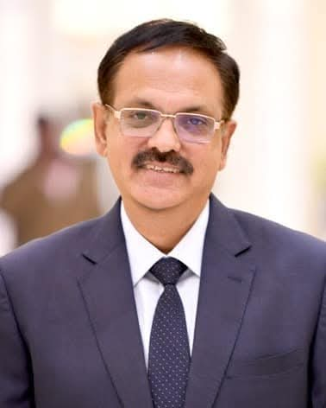
A Legacy of Excellence
35+
10000+
50+
Years in Practice
Surgeries Performed
Conference Presentations
Serving patients since 1987
Complex ENT procedures
National and International
Dr Adesh Saxena represents the perfect synthesis of medical excellence, leadership, and humanitarian service. His journey from gold medallist to healthcare leader exemplifies dedication to advancing ENT care whilst enriching communities through music, sports, and social service.

Slide 12

Thank You!

